Slide 1
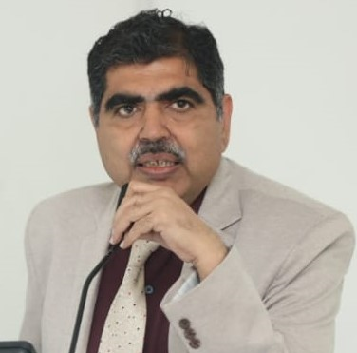
30th International Congress of the Transplantaion Society 2024 at Istanbbul, Turkey
Name: Dr. Anil Kumar
Current Designation: Director, National Organ and Tissue Transplant Organization (NOTTO) and Addl.DDG
Present Affiliation:: NOTTO, Ministry of Health, Govt. of India
Major Achievements (Honors) and Awards:
Head National Organ Transplant Programme & Nodal officer, Transplant Rules 2014
Chair, Hospital Planning Sectional Committee, BIS
Trained Expert in Transplant Registry, Coordination & Patient Safety
Member Secretary, Indian Public Health Standards, 2012 and Co-Chair IPHS 2022
Chair Bio Medical Waste Management rules drafting committee 2016
Ex-Director, National Blood Transfusion Council, G.o.I

