Slide 1


Results from the SUMMIT Study: SUccessful transplantation with Marginal (DRI>1.5) deceased donor kidneys - Identifying determinanTs
Hemant Sharma¹, Zaid Al-Ameidy¹, Abhishek Sharma², Sanjay Mehra¹
¹Transplant Surgery, Royal Liverpool University Hospital, Liverpool, United Kingdom
²Data Analytics , Loyola University , Chicago, IL, United States

Slide 2
Authors have no conflict of interest to report

Slide 3
Background
There has been a constant rise in donor age in the organ pool
The average donor quality has deteriorated over last decade
This has generated new challenges for optimising organ use
Henceforth allocation system now based on graft longevity
Notes:
NHSBT 2010-2011, the majority of deceased organ donors (57%) were between 41-60 years old. Only 7% of deceased donors were over 70; in 2020-21 the majority (59%) of deceased donors were aged 50-69. 11% were over 70.
The Health Survey for England estimated there were around 12.8 million obese adults in 2019, up from around 10.7 million in 2010. Hospital admissions for diabetes rose from around 321,000 in 2009-2010 to over 500,000 in 2019-2020.

Slide 4
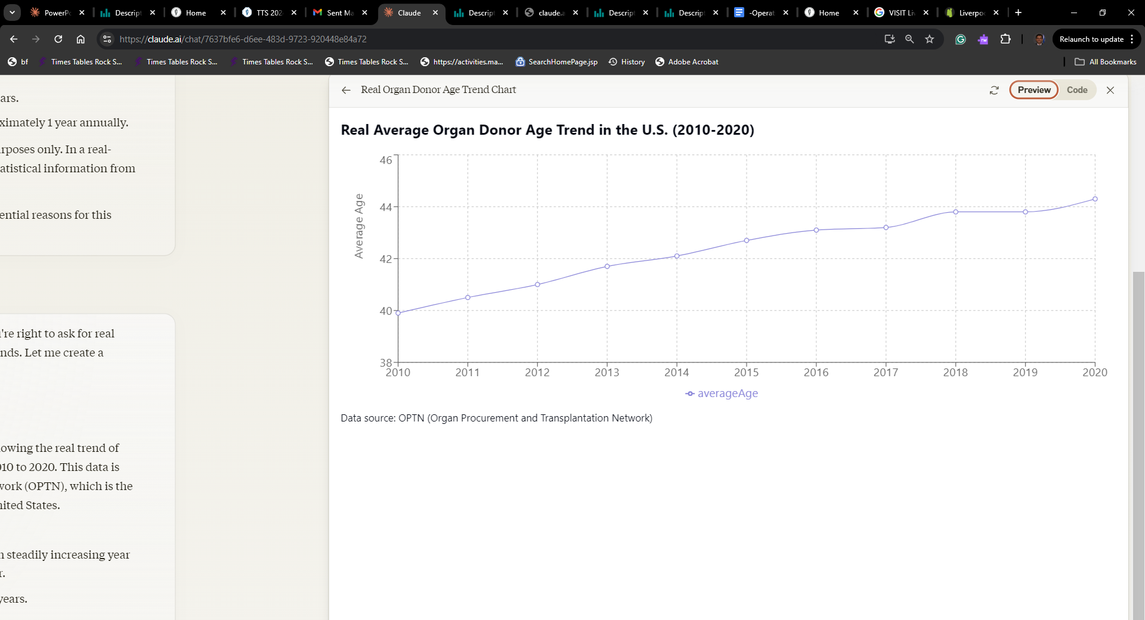
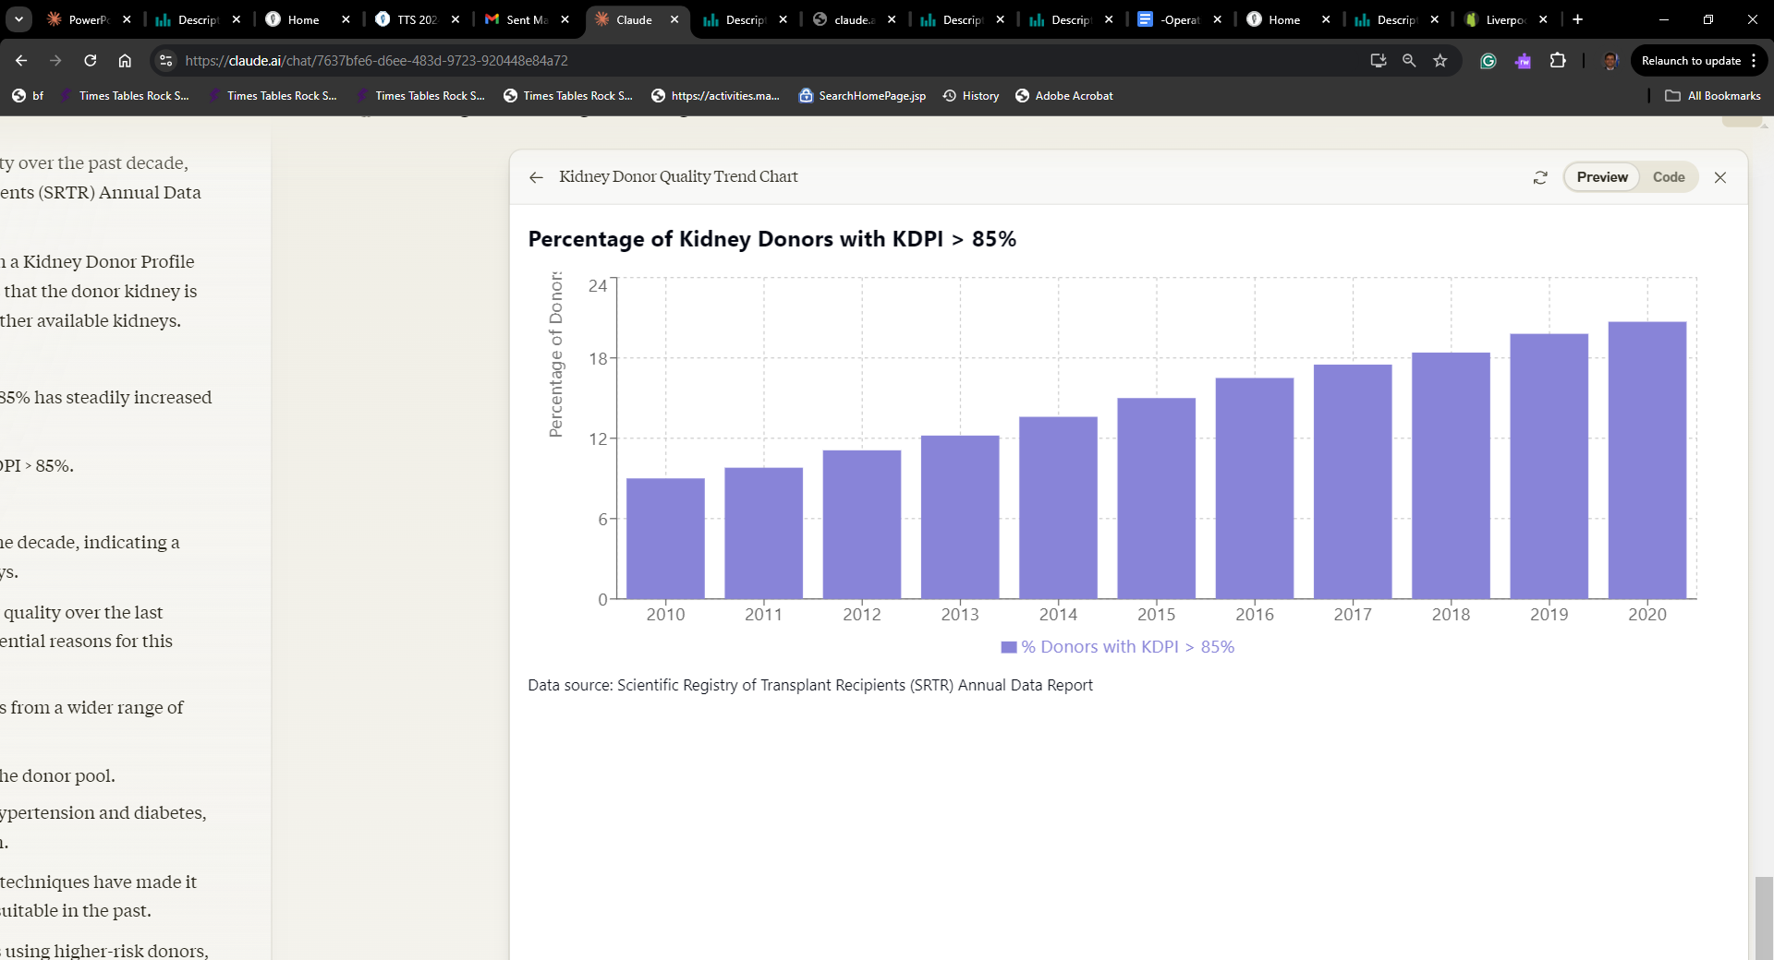

Slide 5
Outcome Measure | KDPI >85% | Comparison (KDPI 0-20%) | Source
5-year graft survival | 55.7% | 78.1% | OPTN/SRTR 2018 Annual Data Report
5-year patient survival | 75.4% | 89.9% | OPTN/SRTR 2018 Annual Data Report
1-year acute rejection rate | 14.7% | 11.6% | Massie et al., Am J Transplant, 2016
Delayed graft function rate | 39.5% | 15.8% | OPTN/SRTR 2018 Annual Data Report
Median 1-year eGFR (mL/min/1.73m²) | 45.9 | 61.2 | OPTN/SRTR 2018 Annual Data Report

Slide 6
Cumulative Mortality Rates (%)
Year | KDPI 0-20% | KDPI 21-85% | KDPI >85% | Waitlisted
0 | 0.0 | 0.0 | 0.0 | 0.0
1 | 3.0 | 4.5 | 7.0 | 8.5
2 | 5.5 | 7.8 | 12.0 | 16.2
3 | 7.8 | 11.0 | 17.0 | 23.1
4 | 9.8 | 14.0 | 22.0 | 29.2
5 | 11.9 | 16.8 | 26.6 | 34.7
Data Source: UNOS/OPTN 2020

Slide 7
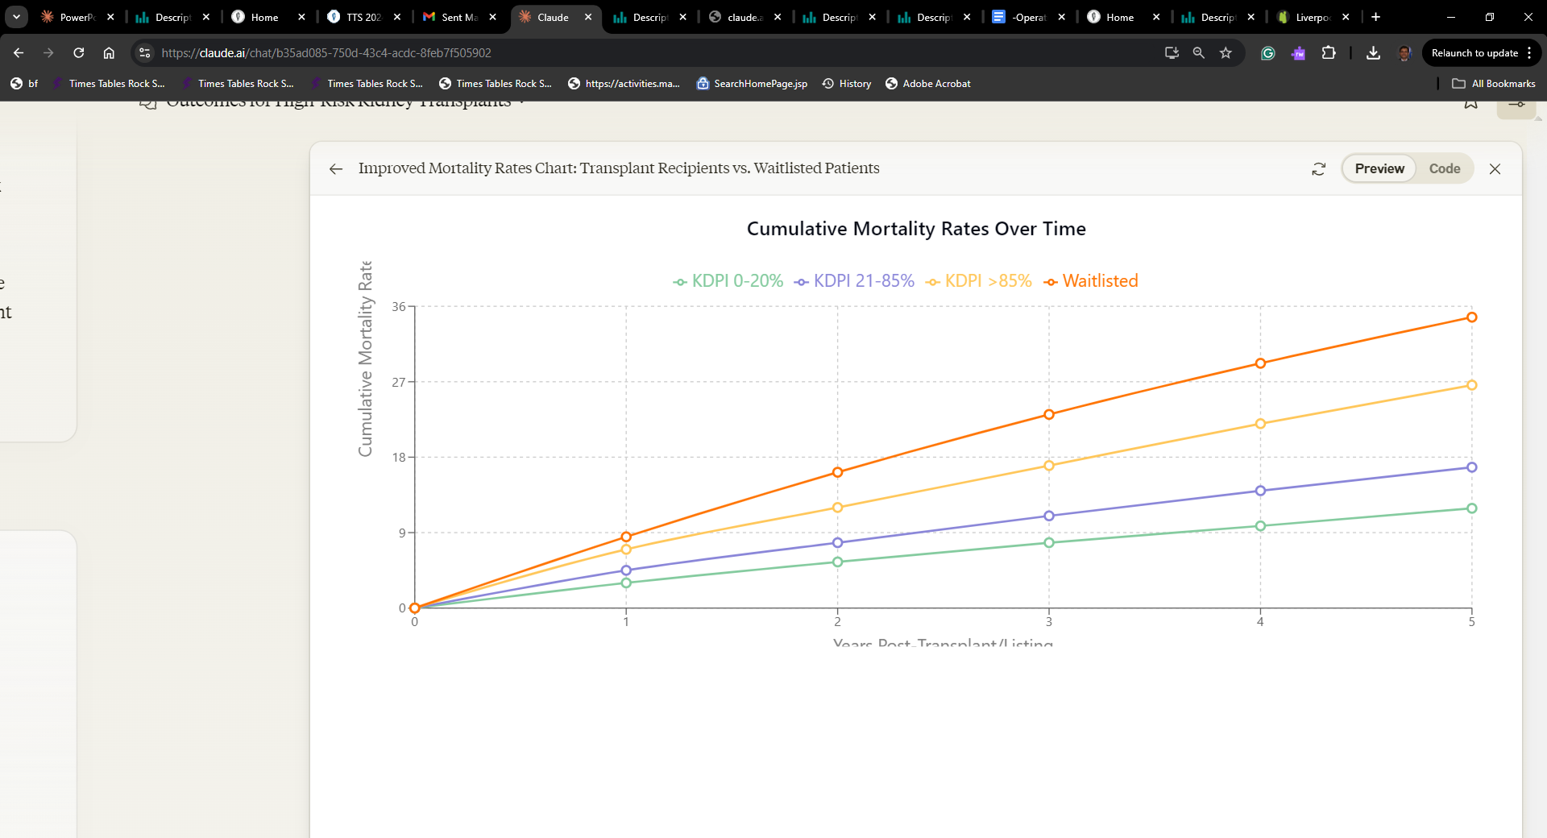
Cumulative Mortality Rates Over Time
Year | KDPI 0-20% | KDPI 21-85% | KDPI >85% | Waitlisted
0 | 0.0 | 0.0 | 0.0 | 0.0
1 | 3.0 | 4.5 | 7.0 | 8.5
2 | 5.5 | 7.8 | 12.0 | 16.2
3 | 7.8 | 11.0 | 17.0 | 23.1
4 | 9.8 | 14.0 | 22.0 | 29.2
5 | 11.9 | 16.8 | 26.6 | 34.7
Data Source: UNOS/OPTN 2020
Receiving a kidney with KDPI >85% reduced the 5-year mortality risk by 23.3% compared to remaining on the waiting list

Slide 8
Cumulative Mortality Rates Over Time
Limited Data from Europe about use of these Supra-marginal kidneys

Slide 9
Background
NHS Blood and Transplant (NHSBT) is a special health authority, sponsored by the Department of Health and Social Care, UK
It is responsible for the supply of blood, organs, tissues and stem cells
NHSBT allocation now primarily utilizes donor based on donor risk index ( DRI)

Slide 10
Background
UK donor risk score (DRI) is calculated for each donor on offer using 7 risk factors. A donor is then categorised in to one of 4 groups based on the risk score D1 (lowest risk), D2, D3 and D4 (highest risk)
DRI = 0.023 x (donor age-50) + -0.152 x ([donor height -170]/10) + 0.149 x (history of hypertension) + -0.184 x (female donor) + 0.190 x (CMV +ve donor) + -0.023 x ([offer eGFR -90]/10) + 0.015 x (days in hospital)
  D1 ≤ 0.79
  D2 0.79 – 1.12
  D3 1.13 – 1.50
  D4 ≥1.50

Slide 11
Purpose
The DRI was available for all donors in the UK since year 2000
Marginal Donor 4- D4 ( Donor Risk Index ≥1.50 ) Matching was introduced as a part of new Kidney allocation scheme in the UK in 2018
The focus is primed at recipient matching but the role and outcomes of types of transplant for these donors is unreported
We aimed to study the predictors associated with survival outcomes for DCD and DBD transplants from D4 Donors
Notes:
the Donor Risk Index has been available since 2000 to evaluate all donors. In 2018, the UK adopted a new Kidney allocation system that incorporated matching with DRI as a part of allocation

Slide 12
Study Objective
Develop machine learning model using national registry data
Predict factors associated with favorable outcomes
Focus on supra-marginal D4 (DRI >1.5) deceased donor kidneys

Slide 13
Study Design
Retrospective cohort study
UK Transplant Registry data (2000-2019)
6,254 adult recipients of first kidney transplants from D4 donors

Slide 14
Methods
We harmonized the NHSBT Data to shortlist the D4 criterion kidneys since year 2000 to 2019
The Predictors of Transplant outcomes were evaluated by five Machine Learning Classifiers including Logistic regression, SVM, Random forest, K-Nearest neighbour matching and Adaptive boosting
Random Forest Model had the best performance validated by RMSE
Predictors data mined from MLA were further mined with Cox Regression
Notes:
RMSE stands for Root Mean Squared Error, It measures the absolute error between predicted and actual values. Lower values of RMSE indicate better model performance., Predictors were first identified through data mining the Machine Learning Algorithm (MLA). To confirm the significance of these predictors, they were further analyzed using Cox Regression.

Slide 15
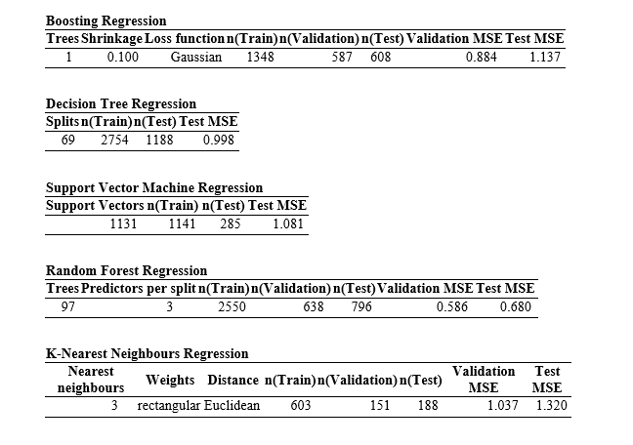
MLA Mining Algorithms
Notes:
These are 5 models of Machine Learning Algorithms.

Slide 16
Machine learning Algorithms:
Notes:
Random Forest Model had the lowest RMSE and was used for further analysis.

Slide 17
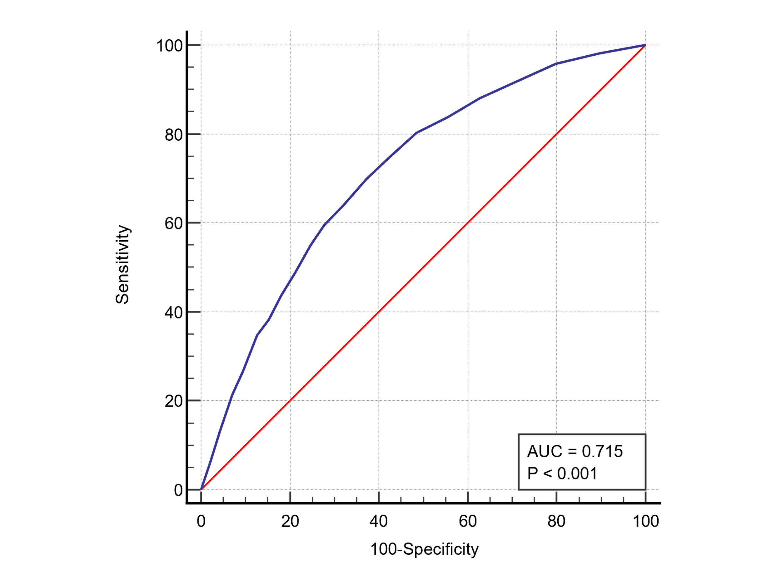
ROC - AUC
Performance metrics
 | Value
AUC | 0.715
Precision | 0.905
Notes:
AUC stands for 'Area Under the ROC ( Reciever Operated Curve) , AUC ranges from 0 to 1. A higher AUC indicates better model discrimination, A model with AUC of 0.715 has moderate accuracy. A high precision value of >90% means the model had a low false positive rate.

Slide 18
Baseline Characteristics- (N=6254 D4 / 56895 Total Tx)
Characteristic | Overall Cohort | DBD | DCD | p-value
Recipients (n) | 6254 | 3793 | 2461 | -
Recipient age (years) | 58 (18-85) | 63 (18-85) | 58 (18-83) | <0.001
Female | 2237 (36%) | 1428 (38%) | 809 (33%) | 0.7
BMI (kg/m2) | 26 (10-46) | 26 (16-43) | 27 (15-47) | 0.09

Slide 19
Baseline Characteristics
 |  | Donor TYPE (N=6254 D4 / 56895 Total Tx)
 |  | DBD | DCD
Number | Frequency | 3793 | 2461
fWIT CIT | Median Median | 15 (01-54) hr | 18 (05-198) min 13.5( 01-36) hr p - NS
Notes:
Approx 10% of all transplants were from D4 donors,

Slide 20
Donor Characteristics
Characteristic | Overall Cohort | DBD | DCD | p-value
Donor age (years) | 63 (16-92) | 63 (18-92) | 58 (16-89) | 0.08
Donor hypertension | 1379 (22%) | 834 (22%) | 545 (22%) | 0.9
Donor diabetes | 369 (6%) | 248 (7%) | 121 (5%) | 0.001
Cold ischemia time (hours) | 18 (2-36) | 18 (2-36) | 18 (2-36) | 0.8

Slide 21
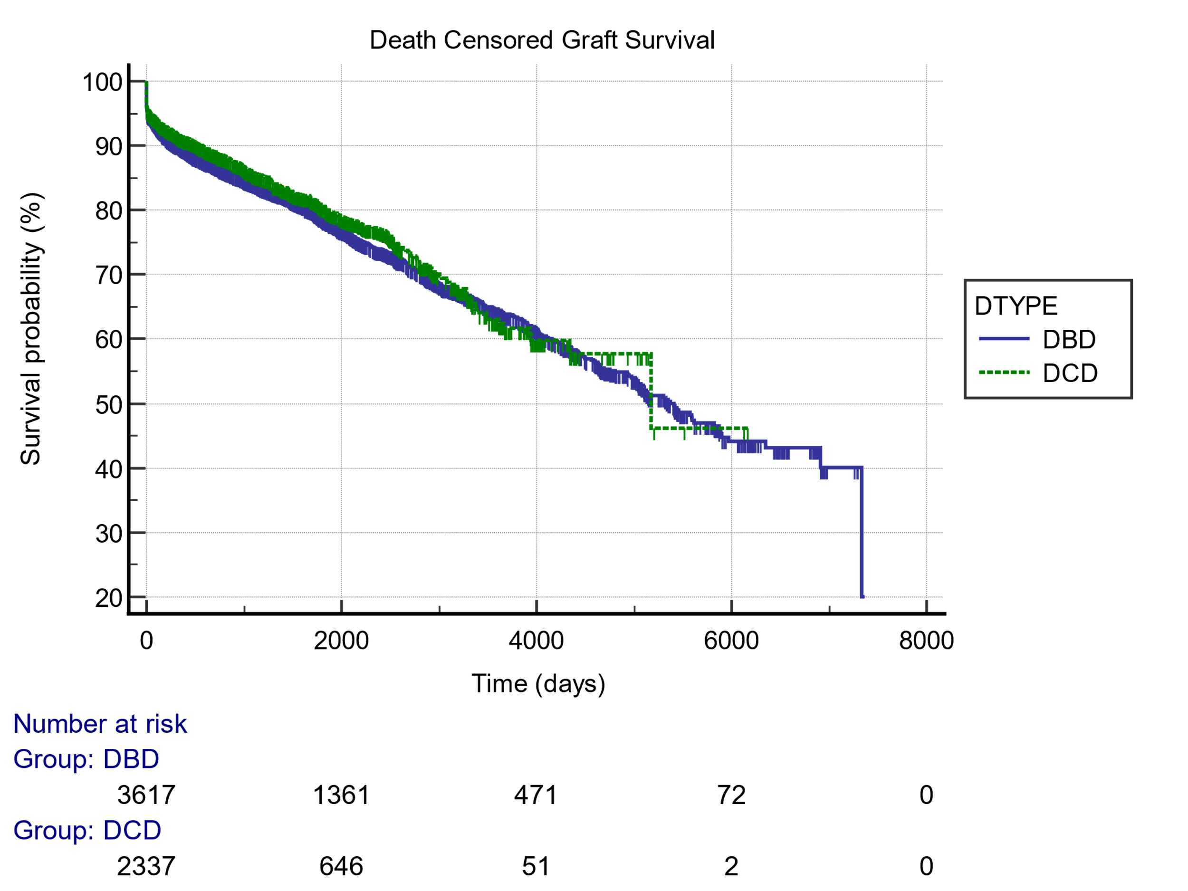
Graft Survival | 1 year | 3 year | 5 year
DBD | 90% | 85% | 81%
DCD | 89% | 84% | 80%
Notes:
This Graph indicated that graft survival was similar in both groups . This data correlates to similar experience from registry data analysis from UNOS database.

Slide 22
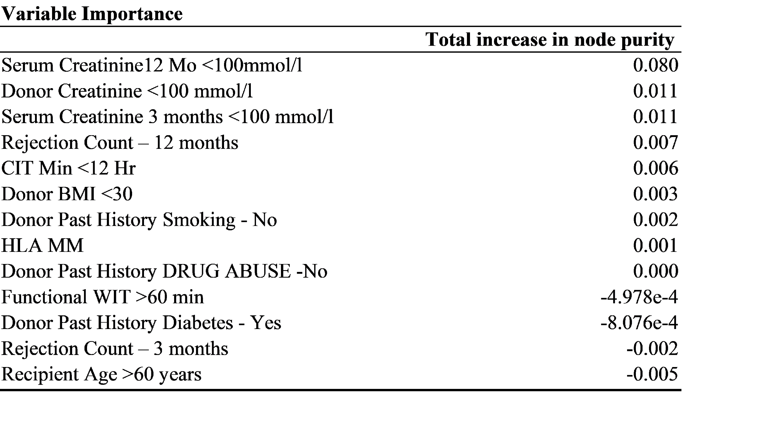
Graft survival
5 years
Notes:
Variables of cumulative survival at 5 years in order of importance. Negative node purity shows adverse effect on graft survival.

Slide 23
< 3 MM
Notes:
Sometimes MLA springs surprises, early rejection shows association with early graft loss, in comparison late rejections have the less accumulated injury, more stabilized immunity, milder inflammation, spared vasculature, lower immunologic risk Thus graft outcomes tend to be better when rejection is late rather than early post-transplant.

Slide 24
Cox Logistic Regression
 |  |  |  | Wald Test
 | Std Error | Odds Ratio |  | Wald Statistic | df |  | p
(Intercept) | 0.585 | 0.090 |  | 16.968 | 1 |  | < .001
RAGE <75 | 0.006 | 0.977 |  | 15.020 | 1 |  | < .001
RBMI <30 | 0.016 | 0.962 |  | 5.881 | 1 |  | 0.015
DRET_CREAT >100 | 0.002 | 1.005 |  | 8.099 | 1 |  | 0.004
CIT >12 hr | 0.000 | 1.001 |  | 10.014 | 1 |  | 0.002
Serum Creat 3 >100 | 0.001 | 1.999 |  | 0.285 | 1 |  | 0.043
Serum Creat 12 >100 | 0.001 | 1.010 |  | 83.431 | 1 |  | < .001
Rejection 3 mo | 0.188 | 1.666 |  | 7.369 | 1 |  | 0.007
Rejection 12 mo | 0.173 | 1.018 |  | 0.010 | 1 |  | 0.020
Odds of DGF and PNF in DCD Kidneys was significant ( 1.7 (1.5-1.44) p <0-001, 1.2( 1.1- 1.6) p=0.02 respectively
Notes:
All variable from MLA were statistically significant , in addition Recipient age and Recipient BMI were also statistically significant

Slide 25
Comparison of Outcomes by Recipient Age
Outcome | Recipients <60 years | Recipients ≥60 years | p-value
5-year graft survival | 83% | 78% | p=0.01
DGF | 34% | 37% | p=0.05
PNF | 2.8% | 3.2% | p=0.04
1-year rejection | 5.7% | 6.3% | p=0.03

Slide 26
Patient Survival Outcomes vs. Waitlisted Patients
Group | 1-year | 3-year | 5-year
Recipients <60 years | 96% | 92% | 87%
Recipients ≥60 years | 94% | 88% | 83%
Waitlisted patients* | 93% | 85% | 75%

Slide 27
Clinical Implications of the SUMMIT Study
D4 kidneys can achieve excellent outcomes with careful recipient selection
Potential to expand donor pool and increase transplantation access
Quantitative tools for estimating post-transplant prognosis
Guidance for optimizing donor-recipient matching

Slide 28
Conclusion
The MLA model accurately predicts variable of importance
There is no statistical difference in DCD versus DBD transplant survival outcomes for D4 kidneys
Potential to significantly increase transplantation access and improve patient outcomes
Validation of model with larger Registry data (UNOS) is under progress
Notes:
Validated by regression of variable of importance,

Slide 29
What Next from Our Research Group
PROFIT STUDY: Predictors of Renal Graft Failure in Benchmark Kidney Transplant – A UK Transplant Registry Analysis
Analysis under way

Slide 30

Thanks

