Slide 1
Is native nephrectomy almost a must in low-weight pediatric kidney transplant patients?
Basak Akyollu¹, Cemile Pehlivanoglu², Cihan Karatas¹, Emre Arpali³, Ilmay Bilge², Burak Kocak¹.
¹Organ Transplantation, Koc University Hospital, Istanbul, Turkey;
²Pediatric Nephrology, Koc University Hospital, Istanbul, Turkey;
³Organ Transplantation, Medical College of Wisconsin, Milwaukee, WI, United States

Slide 2
I confirm that I don’t have any commercial or other interest in the subject/matter of the work that will be presented in this presentation

Slide 3
Introduction
There is no consensus about indications and optimal timing for native nephrectomy (NNx) in pediatric kidney transplant (KTx) patients.

Slide 4
Methods
This is a single center retrospective study reviewing pediatric KTx patients in terms of indications, timing and complications of NNx.
Patient and graft survivals were calculated with Kaplan-Meier survival analysis.

Slide 5
Results
Between July 2008 and December 2023, 112 children underwent living-related KTx.
Median recipient age was 3 years (range 0,6-17,4 years) with median body weight of 21,2 kg (range 6,4-47 kg).
NNx was performed in 42 patients (37,5%) in total. We performed NNx in 34 (30,3%) recipients in our instution and body weight was <15 kg in 25 of the patients (73,5%) (Figure 1 and Table 1).
Only one 10-month-old, 6,4 kg patient with ARPKD had staged nephrectomy prior to KTx and the rest of the NNx were done simultaneously.
6 patients had a history of unilateral and 2 patients had a history of bilateral NNx performed in outer centers prior to their transplant.
The median time interval to transplant following NNx was 24 months (range 3-132 months).

Slide 6
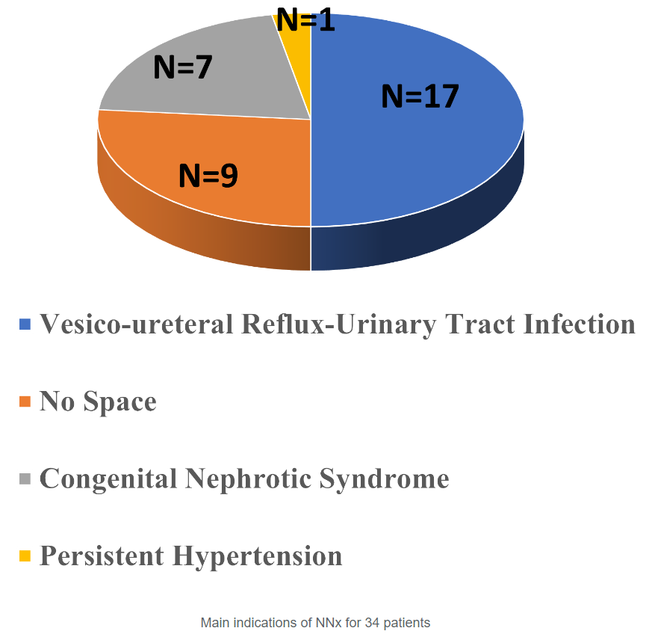
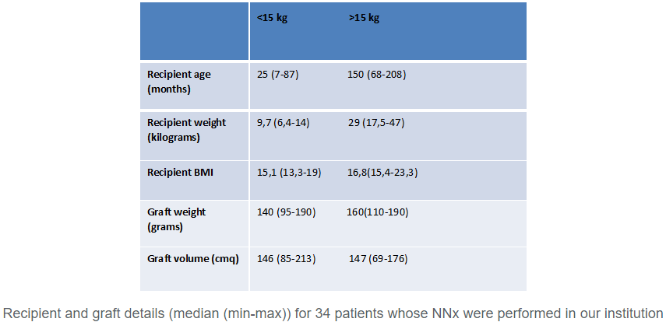
Results

Slide 7
Results
25 of the total 37 low weight pediatric KTx patients (68%) required NNx in the whole series.
Transabdominal approach was the choice in 28 patients including staged NNx case and the rest were performed by retroperitoneal approach with extended right sided hockey stick incision.
All of the bilateral NNx (n=20) and all (n=2) left sided unilateral NNx were done by transabdominal approach.
In 12 patients we performed right sided unilateral NNx by retroperitoneal approach with extended right sided hockey stick incision for the 6 patients and for the rest of the 6 patients transabdominal approach was the choice.
All patients with NNx are alive with well-functioning allografts at 19,2 months (range 0,6-62,6 months) of median follow up period.
Overall patient and graft survivals are 98,2% and 97,3% respectively at 20,6 months (range 0,4-66,5 months)

Slide 8
Results
The post-operative surgical complications in patients who had NNx in our instution were intestinal obstruction (n=2) and one of these 2 patients had also developed urine leak (n=1) which required laparotomy during the follow up and the other one had a history of a previous intraabdominal surgery naming left surrenalectomy for a neuroblastoma 3 years before the KTx.
The other complications were evisceration (n=1) and surgical site hemorrhage (n=1) which received red blood cell transfusion as the sole management for the bleeding.
There was no arterial/venous thrombosis nor uretero-vesical stricture of implanted grafts.
One of our patient who had a history of bilateral NNx in outer center 2 years before KTx due to Wilms tumor, whose KTx was performed by retroperitoneal approach, developed ileus at post-operative day 5 which also required laparotomy.

Slide 9
Conclusion
NNx at the time of KTx is a safe procedure with manageable morbidities especially in low body weight children.

