Slide 1

Novel method of immune monitoring based on alloreactive T cells
Department of Gastroenterological and Transplant Surgery,
Graduate School of Biomedical and Health Sciences, Hiroshima University
Ryosuke Arata, Naoki Tanimine, Ryosuke Nakano, Hiroshi Sakai, Seiichi Shimizu
Hiroyuki Tahara, Masahiro Ohira, Kentaro Ide, Yuka Tanaka and Hideki Ohdan
Notes:
宜しくお願いします。

Slide 2
Introduction
The detailed analysis of alloreactive T cells provides critical insights into transplant immunology. Our study confirmed that the analysis method focusing on alloreactive T cells accurately reflects the rejection response following mouse skin transplantation.
In this research, we further evaluated the utility of this method using a peripheral immune tolerance model.

Slide 3
Method
Peripheral immune tolerance was induced using CTLA-4-IgG and anti-CD40L antibodies in a skin transplantation model (BALB/c→C3H or B6). Seven days after transplantation, B cells derived from BALB/c mice were activated with CD40L and IL-4 for 24 hours, cultured as stimulators, and then co-cultured with recipient spleen T cells for 18 hours in a one-way MLR.
Alloreactive T cells (CD154+CD137+) were identified and functionally evaluated within CD4+CD8+ T cells using flow cytometry.

Slide 4
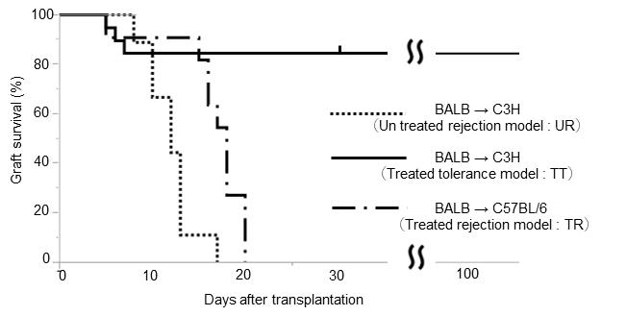
Skin Transplantation
Un treated model
Day 7
BALB
C3H
Treated model
C3H
BALB
* Day 0,2,4,6 CTLA4-ig (200µg i.p.)
Day 0,2,4 MR1 (aCD40L, 250µg i.p.)
B6
* C.P. Larsen et al. Nature 1996
In the BALB/c→C3H model, immunosuppression successfully resulted in skin graft survival.
However, in the BALB/c→B6 model, despite the extension of the rejection period due to immunosuppression,
graft survival was not achieved.

Slide 5
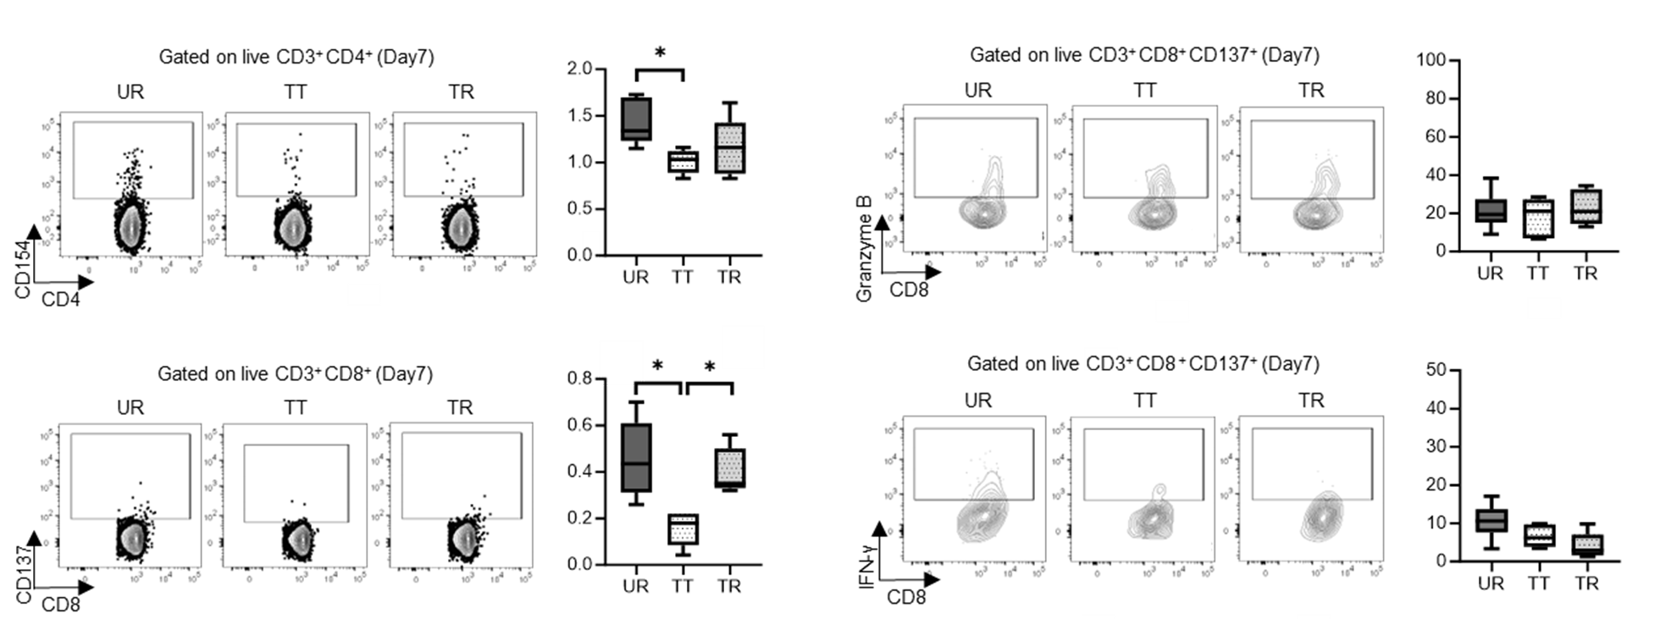
Proliferation assay
CD4+ and CD8+ cell proliferation was lower in the treated model (TT) compared to the untreated model (UR), with no significant differences observed among treated models.
Un treated rejection model : UR
Treated tolerance model : TT
Treated rejection model : TR

Slide 6
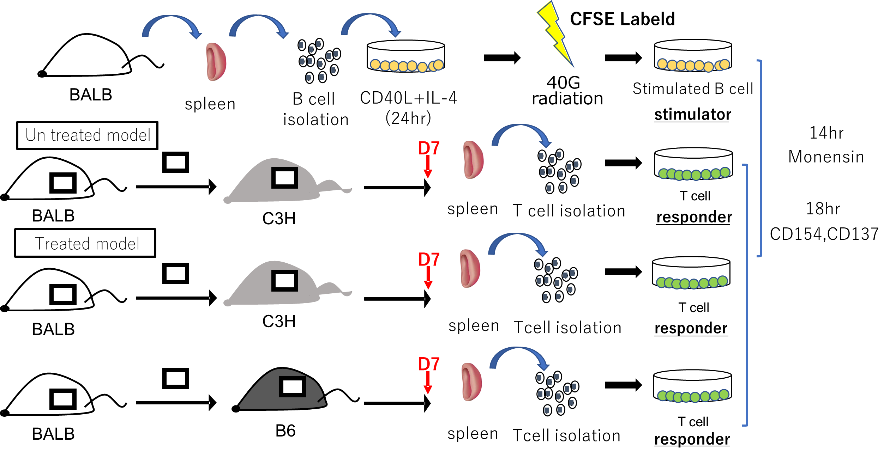
Allo-reactive assay

Slide 7
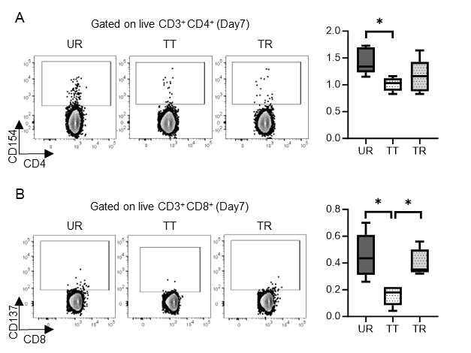
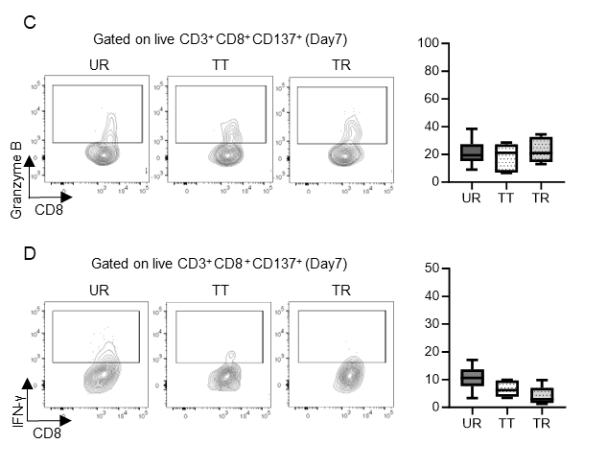
Allo-reactive T cells (CD4⁺CD154⁺, CD8⁺CD137⁺)
The Treated model (TT) showed a lower proportion of alloreactive T cells compared to the Untreated model (UR), and the Treated model (TR) had a lower proportion of alloreactive CD8⁺ T cells.
Un treated rejection model : UR
Treated tolerance model : TT
Treated rejection model : TR

Slide 8
Granzyme B and INF-γ (Gated on live CD8⁺CD137⁺)
No significant differences in the expression of Granzyme B and IFN-γ were observed between the treated model (TT) and the untreated model (UR) or among the different treated models (TT and TR).
Un treated rejection model : UR
Treated tolerance model : TT
Treated rejection model : TR

Slide 9
Result
Differences between treated models that were not observable through cell proliferation evaluation were effectively assessed by focusing on alloreactive T cells.
The analysis of alloreactive T cells provides an effective method for identifying changes in T cell responsiveness during the induction and maintenance phases of immunosuppression in mouse skin transplantation. This approach suggests that quantitative and qualitative analyses of alloreactive T cells are useful for monitoring immune responses post-transplantation.

Slide 10
Conflict of Interest Disclosure
There are no conflicts of interest to disclose related to this presentation.

