Slide 1
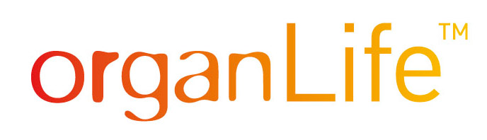
GELOFUSIN CAUSES EDEMA FORMATION IN NORMOTHERMICALLY PERFUSED PORCINE KIDNEY GRAFTS
Marlene Pühringer¹, Bradley Hovan², Piper Curtis², Andrew Capulli², Joshua Filgate², Michael Mengel³, Stefan Schneeberger¹, Franka Messner^{1*}
¹ OrganLifeTM Laboratory, Medical University of Innsbruck, Innsbruck, Austria
² DEKA Research and Development, Manchester, NH, USA
³ University of Alberta, Edmonton, Alberta, Canada
* Disclosure: Consulting fees for NefroHealth

Slide 2
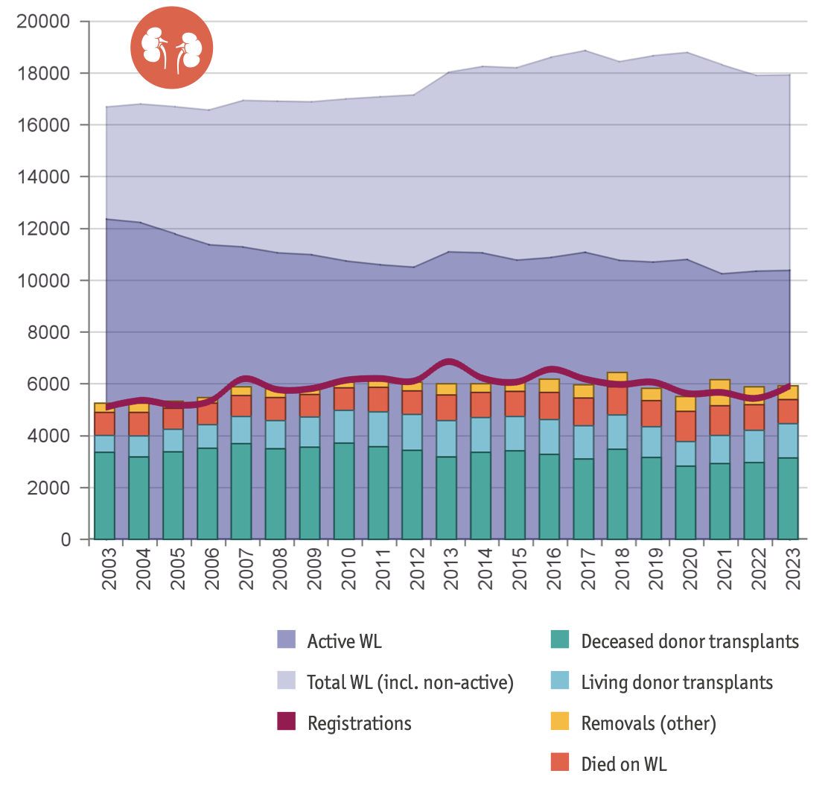
Background & Aim
Kidney waiting list dynamics in Eurotransplant
Severe organ shortage, especially in kidney transplantation
NMP may help to increase organ utilization through:
  Organ quality assessment
  Advanced preservation technology
Consensus on preferred perfusion protocol and perfusate composition in kidney NMP is lacking
AIM: Identify a suitable colloid solution for kidney NMP using a novel preservation device
Eurotransplant Annual Report 2023, https://www.eurotransplant.org/statistics/annual-report/
Medical University of Innsbruck

Slide 3
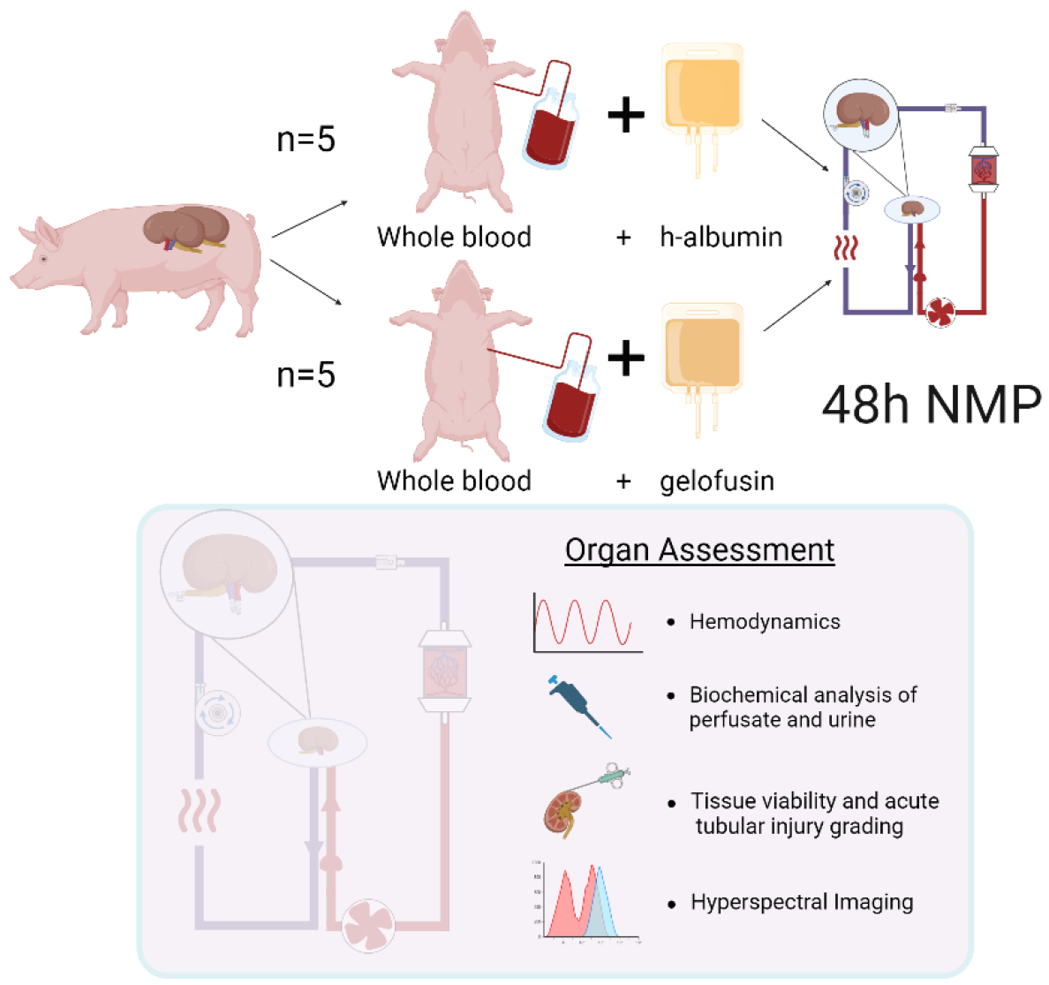
Methods & Study Design
NMP for 24 hours in 5 porcine kidney pairs
Continuous flow perfusion with novel prototype kidney NMP device at 90 mmHg
Automated oxygenation and nutrient supply managed by onboard sensors
Perfusate: autologous leukocyte-filtered whole blood +
  5% human albumin
  or
  Gelofusin
24 h NMP

Slide 4
Results
(A) Hemodynamic parameters during NMP. Renal resistance (RR) of porcine kidneys during NMP with whole-blood and albumin vs. whole-blood and gelofusin differed significantly (*p<0.05; median [IQR] displayed). (B) Injury markers in the perfusate rose similarly between groups without reaching statistic significance. (C) Banff grading was zero for most parameters, solely indicating a trend towards mesangial matrix increase (not significant). (D) & (E) In contrast to the Albumin group, the Gelofusin-group showed a significant (*p<0.05) weight gain (delta weight = grams difference before and after NMP) after 24 hours of NMP, potentially accounting for edema formation. (F) These findings are supported by HSI data, assessing micro-perfusion and oxygenation. Significantly higher tissue water-indices were found in the Gelofusin group at 6 and 24 hours of perfusion (*p<0.05; median [IQR] displayed). (G) EGTI scoring reveals minor endothelial swelling in some cases, no changes in glomerular appearance, increasing trend of tubular damage and minor changes in the interstitial space after 24 hours NMP.

Slide 5
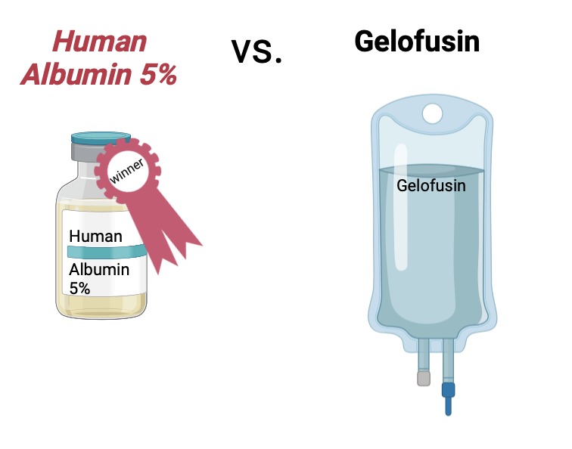
Conclusion
Less weight gain
Significantly lower tissue water-indices

